Slide 1

SWE 321: Data Communication
SWE 321: Lecture 8
Afsana Begum (AB)
Lecturer, Department of Software Engineering

Slide 2
ANALOG-TO-ANALOG CONVERSION:
Analog-to-analog conversion, or analog modulation, is the representation of analog information by an analog signal.
So why we need to modulate an analog signal if it is already analog??
Modulation is needed if the medium is bandpass in nature or if only a bandpass channel is available to us.
The government assigns a narrow bandwidth to each radio station. The analog signal produced by each station is a low-pass signal, all in the same range.
So the low-pass signals need to be shifted, each to a different range.

Slide 3
ANALOG-TO-ANALOG CONVERSION:
Analog-to-analog conversion can be accomplished in three ways:
Amplitude modulation (AM)
Frequency modulation (FM)
Phase modulation (PM).
FM and PM are usually categorized together.

Slide 4
Amplitude Modulation (AM):
In AM transmission, the carrier signal is modulated so that its amplitude varies with the changing amplitudes of the modulating signal.
The frequency and phase of the carrier remain the same; only the amplitude changes accordingly. The modulating signal is the envelope of the carrier.
AM is normally implemented by using a simple multiplier because the amplitude of the carrier signal needs to be changed according to the amplitude of the modulating signal.

Slide 5
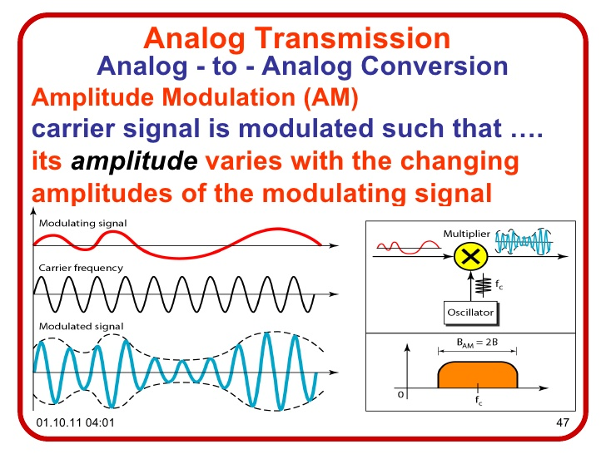
Amplitude Modulation (AM):

Slide 6
AM Bandwidth & Radio:
The modulation creates a bandwidth that is twice the bandwidth of the modulating signal and covers a range centered on the carrier frequency.
The total bandwidth required for AM can be determined from the bandwidth of the audio signal:
B =2B.
The bandwidth of an audio signal (speech and music) is usually 5 kHz. Therefore, an AM radio station needs a bandwidth of 10kHz.
Federal Communications Commission (FCC) allows 10 kHz for each AM station.

Slide 7
AM Bandwidth & Radio:
AM stations are allowed carrier frequencies anywhere between 530 and 1700 kHz (1.7 MHz).
However, each station's carrier frequency must be separated from those on either side of it by at least 10 kHz (one AM bandwidth) to avoid interference.
If one station uses a carrier frequency of 1100 kHz, the next station's carrier frequency cannot be lower than 1110 kHz

Slide 8
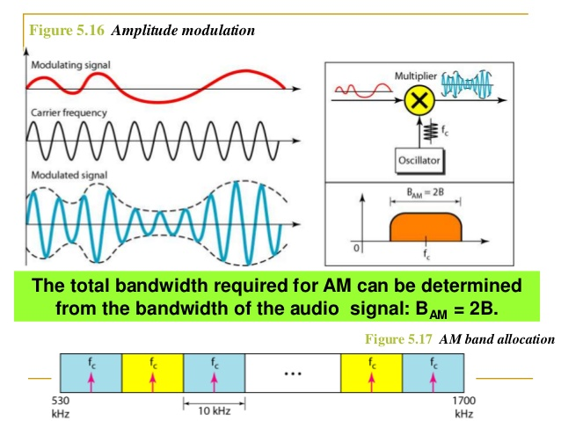
AM Bandwidth & Radio:

Slide 9
Frequency Modulation (FM):
In FM transmission, the frequency of the carrier signal is modulated.
The peak amplitude and phase of the carrier signal remain constant.
FM is normally implemented by using a voltage-controlled oscillator as with FSK.

Slide 10
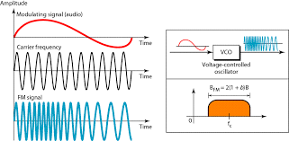
Frequency Modulation (FM):

Slide 11
FM Bandwidth & Radio:
The actual bandwidth is difficult to determine exactly.
But it can be shown empirically that it is several times that of the analog signal or 2(1 + β)B where β is a factor depends on modulation technique with a common value of 4.
The total bandwidth required for FM can be determined from the bandwidth of the audio signal:
B =2(1 + β )B.
The bandwidth of an audio signal (speech and music) broadcast in stereo is almost 15 kHz.

Slide 12
FM Bandwidth & Radio:
The FCC allows 200 kHz (0.2 MHz) for each station. This mean β= 4 with some extra guard band.
FM stations are allowed carrier frequencies anywhere between 88 and 108 MHz.
Stations must be separated by at least 200 kHz to keep their bandwidths from overlapping.
Given 88 to 108 MHz as a range, there are 100 potential FM bandwidths in an area, of which 50 can operate at anyone time.

Slide 13
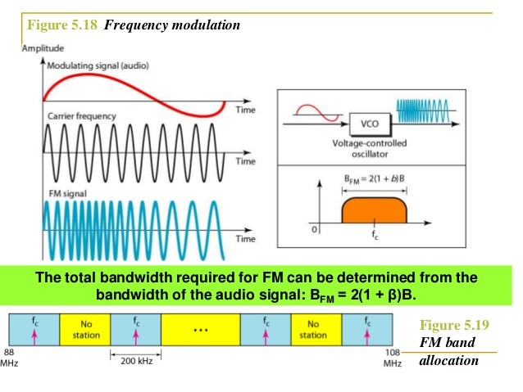
FM Bandwidth & Radio:

Slide 14
Thank You !!!
Any Questions ???

